Slide 1
Introduction to Software Engineering

Slide 2
What is software?
Computer programs and associated documentation
Software products may be developed for a particular customer or may be developed for a general market
Software products may be
  Generic - developed to be sold to a range of different customers
  Custom - developed for a single customer according to their specification

Slide 3
What is Good Software?
The software has a number of attributes that decide whether it is good or bad.
The definition of good software changes with the person who evaluates it.
The software is required by the customer, used by the end-users of an organization, and developed by a software engineer.
Each one will evaluate the different attributes differently in order to decide whether the software is good.

Slide 4
What are the attributes of good software?
The software should deliver the required functionality and performance to the user and should be maintainable, dependable and usable.
Maintainability
  Software must evolve to meet changing needs
Dependability
  Software must be trustworthy
Efficiency
  Software should not make wasteful use of system resources
Usability
  Software must be usable by the users for which it was designed

Slide 5
Software - Characteristics
Software has a dual role. It is a product, but also a vehicle for delivering a product.
Software is a logical rather than a physical system element.
Software has characteristics that differ considerably from those of hardware.
- Software is developed or engineered, it is not manufactured in the classical sense.
- Software doesn’t “wear out”.
- Most software is custom-built, rather than being assembled from existing components.

Slide 6

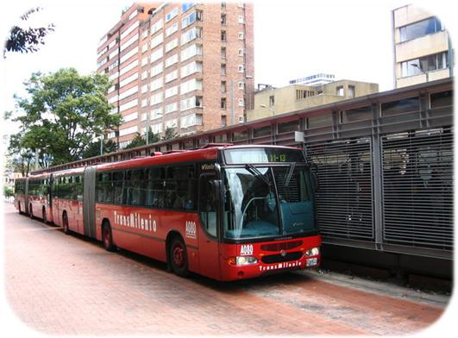
Where can you find software?

Slide 7
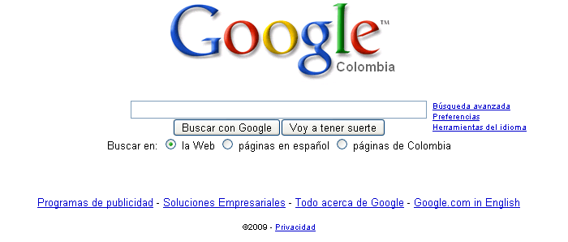
Some popular ones…

Slide 8
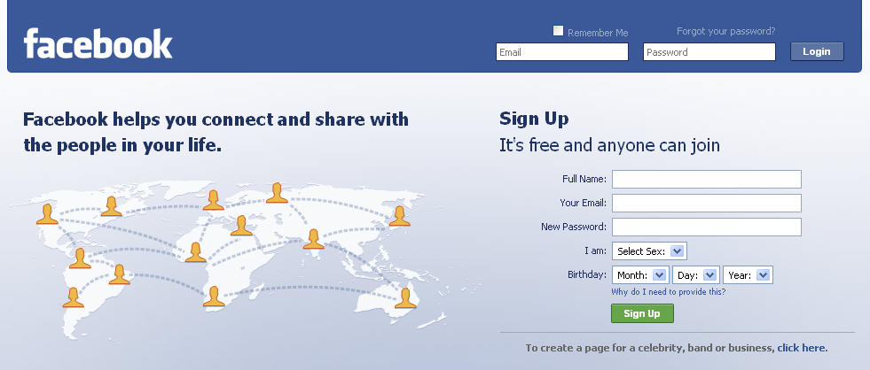
Some popular ones…

Slide 9

Some popular ones…

Slide 10

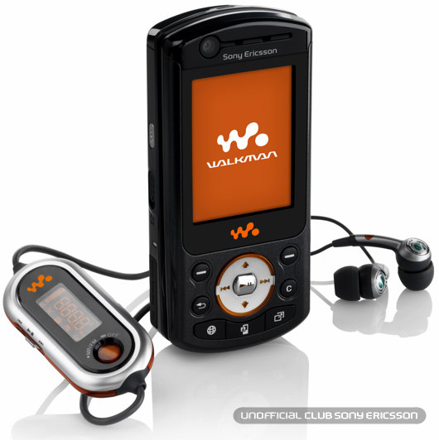
And even in…

Slide 11
Conclusion
Software is Almost
Everywhere.

Slide 12
Common issues
The final Software doesn´t fulfill the needs of the customer.
Hard to extend and improve: if you want to add a functionality later is mission impossible.
Bad documentation.
Bad quality: frequent errors, hard to use, ...
More time and costs than expected

Slide 13
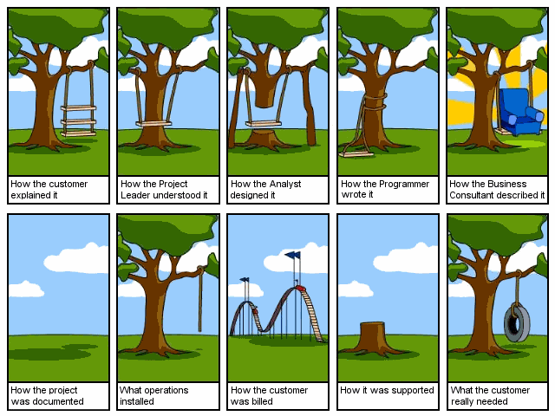
Notes:
i. The final Software doesn´t fit the needs of the customer
ii. Hard to extend and improve: if you want to add a functionality later is mission impossible
Bad documentation, bad software design
iii. Bad quality: frequent errors, hard to use...
iv. More time and costs than expected

Slide 14
Problems in software
development

Slide 15
Limitations of Non-engineered Software
Requirements
Here is the problem!!
Software
Notes:
One of the problems with complex system design is that you cannot foresee the requirements at the beginning of the project. In many cases, where you think you can start with a set of requirements, that specifies the completely the properties of your system you end up with....

Slide 16
Conclusion
Programming is NOT enough!
It is not enough to do your best: you must
Know what to do, and THEN do your best.
-- W. Edwards Deming

Slide 17
And Since…
A clever person solves a problem.
A wise person avoids it.
- Albert Einstein

Slide 18
Solution

Slide 19
Software Engineering
The Application of a systematic, disciplined, quantifiable approach to the development, operation and maintenance of software; that is, the application of engineering to software.

Slide 20
  By “Systematic” we mean
  Following a well-defined sequence of activities,
  - in which desired outputs (deliverables) are well-defined
  - by using well-defined inputs
  (i.e. documented syntax, semantics, context and other relevant properties of the input)
  - in a well-defined process
  (e.g. using organizational standards for interprocess communication, data formats, error handling etc.)
  - whose outputs are in turn used similarly as inputs in the subsequent process(es),
  - until the final output is achieved,
  - and where the correctness of the output is verifiable.
  Note: The “inputs” and “outputs” most often refer to requirements, software specifications, the software itself, documentation, test inputs/outputs and similar software artifacts.

Slide 21
By “disciplined” we mean:
Each process is followed using organizational principles (e.g. who manages whom, who is responsible for what?),
Intermediate results are carefully documented, as well as final results,
Actions are traceable as to their causes, individuals involved, time of occurrence and circumstances.

Slide 22
By “quantifiable” we mean:
The size and extent of the required effort
(size of output code, data, documentation, manpower, duration, budget for development, expected error rate and user support)
are predictable within justifiable and acceptable bounds

Slide 23
Software Engineering
Objective
To produce software that is:
On time: is deliver at the established date.
Reliable: doesn´t crash.
Complete: good documentation, fulfill customer needs.
Notes:
On time: deliver at the established date
Reliable: doesn´t crash often, etc
Complete: good documentation, fulfill customer needs

Slide 24
Stages for software development
Requirements Analysis
Software Design
Implementation
Testing
Maintenance

Slide 25
Why Software Engineering?
Major Goals:
- To increase software productivity and quality.
- To effectively control software schedule and planning.
- To reduce the cost of software development.
- To meet the customers’ needs and requirements.
- To improve the current software engineering practice.
- To support the engineers’ activities in a systematic and efficient manner.

Slide 26
Software Process Model
Linear Sequential Model (LSM)
The Prototype Model (PRM)
The Rapid Application Development Model (RAD)
The Incremental Model (INS)
deployment; make changes for
  Errors, performance
  changes in requirement

Slide 27
Water Fall/Linear Sequential Model (LSM)
It is one of the earliest development models. The linear sequential model provides a systematic approach to software development. In this approach ,the process of software development is represented by a sequence of steps. The sequential phases are what make this model linear, simple and systematic in nature. Each phase must be completed before you can move to next phase. This model is also known as the Waterfall Model or classical life cycle .

Slide 28
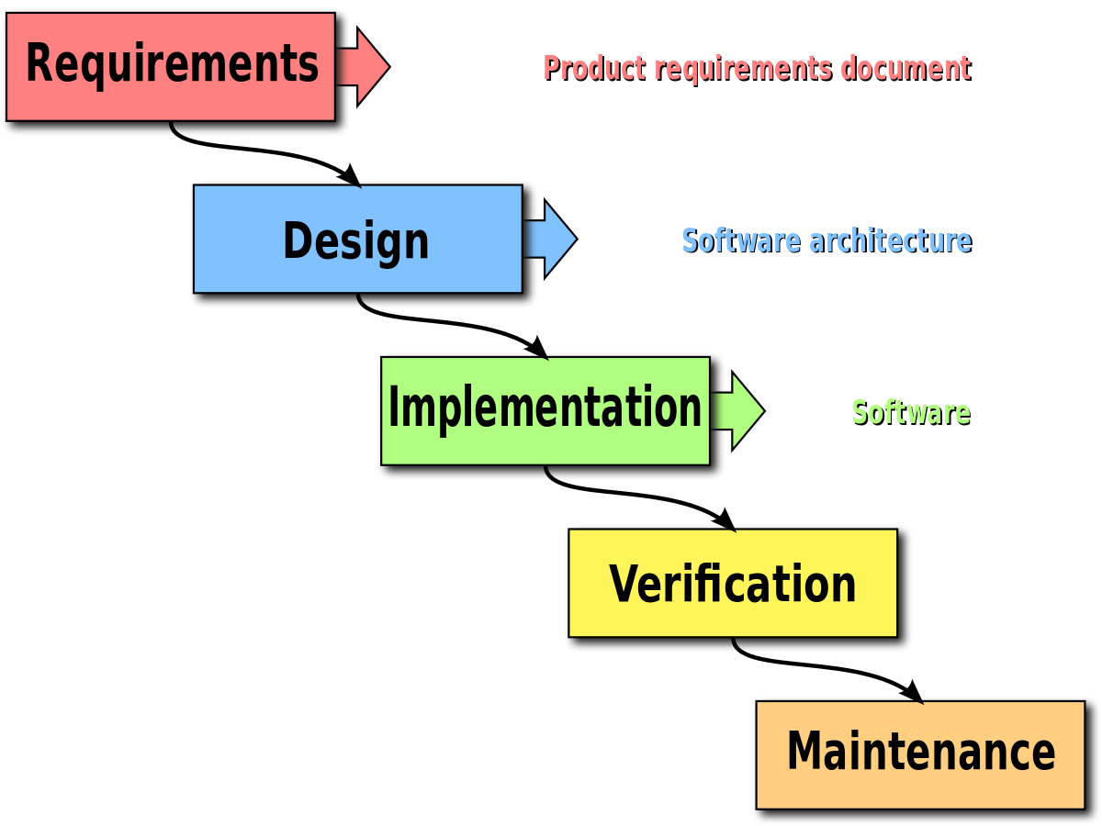
Phases of Linear Sequential Model

Slide 29
Phases of Linear Sequential Model
The following are the phases of LSM:
Software requirement analysis:
In this Phase , the requirements for the software are established through discussion with client and are then documented.

Slide 30
Phases of Linear Sequential Model
Designing:
In this phase , the requirements are converted into design to be used in the next phase. The design includes various elements such as database structures, software architecture and procedures.
The design is first passes through the quality test and then documented.
Coding:
In this phase the actual coding of the software is done. The design of the previous phase is converted into the code.

Slide 31
Phases of Linear Sequential Model
Testing:
In this phase, the output generated is checked to ensure that it matches the requirements. The programs developed in the previous phase are checked for the logical and syntax errors.
Maintenance and Support:
The software developed needs to maintenance and support. This refers to the changes as well as new requirements in the software after delivery.

Slide 32
Advantages of Linear Sequential Model
The Linear Sequential model offers the following advantages:
It is easy to understand and implement.
It prohibits skipping any phase in the sequence.
It is ideal for small projects and when the requirements and goals of the project are well established in advance.

Slide 33
Disadvantages of Linear Sequential Model
The following are the disadvantages using Linear sequential model:
In practical conditions ,software projects are seldom sequential. Iteration and overlapping often occur . This model is not suitable for such projects.
The working version of the software is available to the customer after testing. Therefore, if there is any major error during the coding it will till end of the testing.
Due to linear nature is any phase is not completed , the software analyst and developers cannot proceed further.

Slide 34
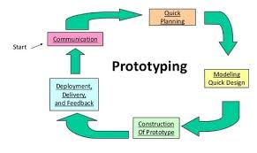
Prototyping model

Slide 35
Prototyping Model
In this model the developer and client interact to established the requirements of the software.
Define the broad set of objectives.
This is follow up by the quick design, in which the visible elements of the software, the input and the output are designed.
The quick design stresses the clients view of the software .
The final product of the design is a prototype.
The client evaluates the prototype and provides its recommendations and suggestion to the analyst.
The process continues in an iterative manner until the all the user requirements are met.

Slide 36
Advantages of Prototyping Model
The following are the advantages of Prototyping model:
Due the interaction between the client and developer right from the beginning , the objectives and requirements of the software is well established.
Suitable for the projects when client has not clear idea about his requirements.
The client can provide its input during development of the prototype.
The prototype serves as an aid for the development of the final product.

Slide 37
Disadvantages of Prototyping Model
The prototyping model has the following disadvantages.
The quality of the software development is compromised in the rush to present a working version of the software to the client.
The client look at the working version of the product at the outset and expect the final version of the product to be deliver immediately. This cause additional pressure over the developers to adopt shortcut in order to meet the final product deadline.
It becomes difficult for the developer to convince the client as why the prototype has to be discarded.

